Slide 1
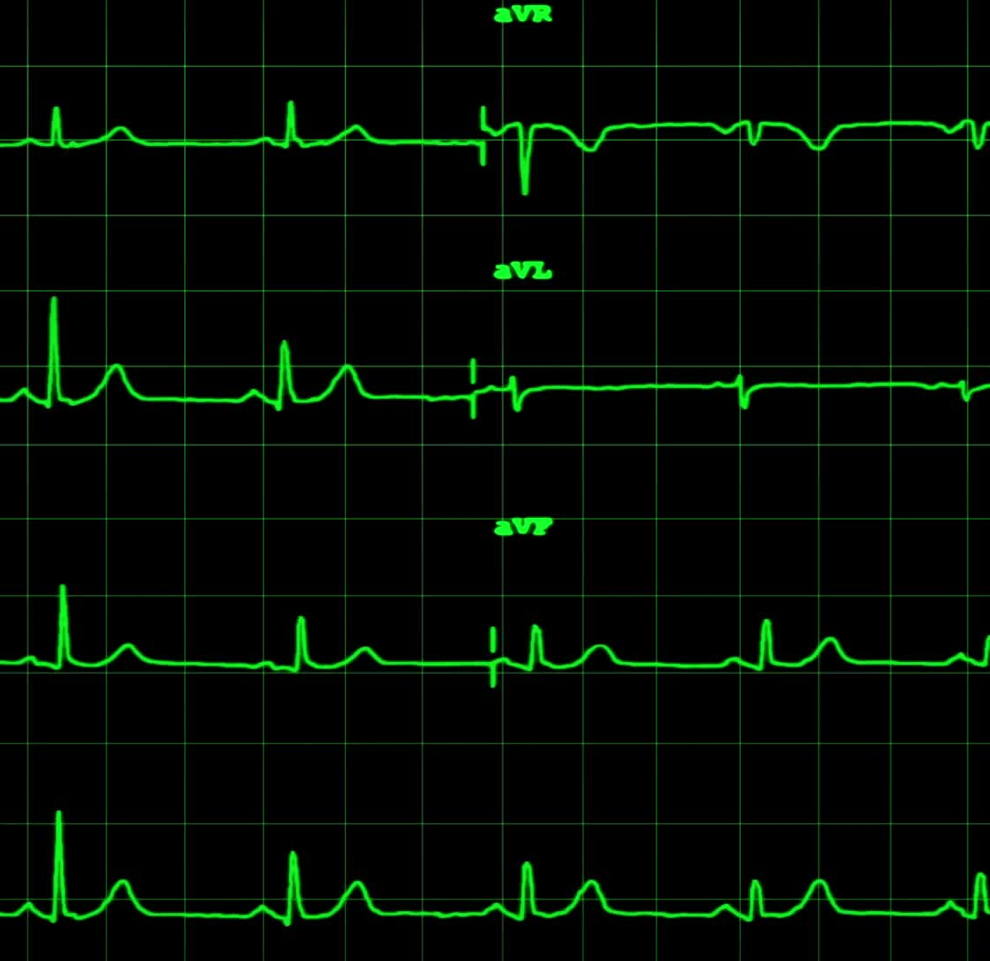
The Cardiovascular (or CV) System: AMI
Anna H. Haro, Pharm.D.
Westside High School
March 2022

Slide 2
LEARNING Objectives TEKS: §130.231.(c)(1)(A, & B) and §130.231.(c)(2)(A, B, C, F, & G) & (3)(B)
Students will apply prior knowledge and skills from Biology to develop new knowledge and skills of the Cardiovascular System.
Students will develop medical terminology of the Cardiovascular System related to an AMI.
Students will explain the physiology of an AMI.
Students will identify the s/sx and risk factors of an AMI.
Students will evaluate the DX, TX, and PX including secondary prevention of an AMI.

Slide 3
LEARNING Objectives TEKS: §130.231.(c)(1)(A, & B) and §130.231.(c)(2)(A, B, C, F, & G) & (3)(B)
Los estudiantes aplicarán conocimientos y habilidades previos de biología para desarrollar nuevos conocimientos y habilidades del sistema cardiovascular.
Los estudiantes desarrollarán la terminología médica del Sistema Cardiovascular relacionada con un AMI.
Los estudiantes explicarán la fisiología de un AMI.
Los estudiantes identificarán el s/sx y los factores de riesgo de un AMI.
Los estudiantes evaluarán el DX, TX y PX, incluida la prevención secundaria de un AMI.

Slide 4
Recap: different CVD
CVD or Cardiovascular Disease describes a large category of dx that affects the function or/and structure of the heart and blood vessels or any part of the CV system. Examples:
AMI – Acute Myocardial Infarction, aka heart attack
HTN – hypertension, also known as high ________ _________
CAD: Coronary Artery Disease or Dyslipidemia – high cholesterol
ASCVD: Atherosclerotic Cardiovascular Disease – both coronary ASCVD and non-coronary ASCVD
Cardiac Arrhythmias
Valvular disorders
Heart Failure
PVD and PAD

Slide 5
Objetivos de aprendizaje TEKS: §130.233.(c)(1)(A, & B) and §130.233.(c)(2)(A, B, C, F, & G) & (3)(B)
Los estudiantes aplicarán conocimientos y habilidades previos de biología para desarrollar nuevos conocimientos y habilidades del sistema cardiovascular.
Los estudiantes desarrollarán la terminología médica del Sistema Cardiovascular relacionada con un IAM.
Los estudiantes explicarán la fisiología de un AMI.
Los estudiantes identificarán el s/sx, factores de riesgo, tx, incluida la prevención secundaria de un AMI.

Slide 6
AMI
Today’s focus will shift to a heart attack or an acute myocardial infarction.
First, let’s look at what causes the heart attack to occur.
https://youtu.be/cLOga_mDwvs
Video from: the National Heart Foundation of New Zealand (https://www.heartfoundation.org.nz/your-heart/heart-conditions/about-heart-attacks)

Slide 7
The link between CAD and AMI
Recall:
CAD or Coronary artery disease is caused by a build-up of cholesterol plaques in the blood vessels of the heart, specifically the coronary arteries. These arteries supply blood and oxygen (and other nutrients) to the heart.
CAD is the main cause of AMI. What is an AMI?
CAD is caused by dyslipidemia or high cholesterol.

Slide 8
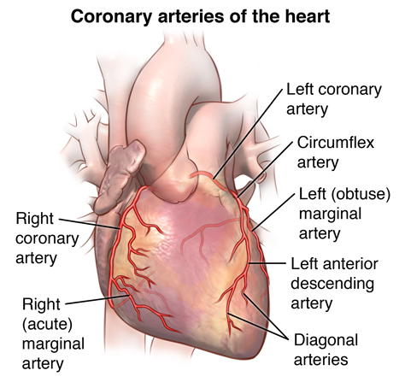
Coronary Arteries
These are the arteries that supply blood, oxygen, and nutrients to the heart (note, these branch off from the aorta and carry oxygenated blood away from the inside of the heart to the heart muscle and exterior heart walls.
If any of these are blocked due to cholesterol plaques or blood clots, then the pt will experience an AMI.
Image from: https://www.hopkinsmedicine.org/health/conditions-and-diseases/anatomy-and-function-of-the-coronary-arteries

Slide 9
The link between CAD and AMI
Dyslipidemia is the 2nd most common chronic disease in the United States affecting more than 100 million patients over 20 years old. What is the most common chronic dx?
High cholesterol is diagnosed based on lab values: total cholesterol in the blood, or TC along with LDL, HDL, and TG. (Be sure to know these abbreviations.)
Are these values objective or subjective?

Slide 10
Cholesterol Lab Values: memorize
Cholesterol labs are called the LP or lipid panel
TC = total cholesterol, goal < 200mg/dL
LDL = low-density lipoproteins (bad cholesterol), goal < 100mg/dL
HDL = high density lipoproteins (good cholesterol), goal > 50mg/dL
TG = triglycerides, goal < 150
If TG > 500mg/dL, it is critical/severe. Pt likely to suffer acute pancreatitis when TG > 500mg/dL
The pt should fast for at least 8 hours for accurate levels. What does this mean?

Slide 11
Cholesterol and AMI physiology
Why do cholesterol levels matter?
Increased LDL and TC are the main risk factors for an AMI!
Don’t forget where cholesterol comes from: both exogenous and endogenous sources can contribute to elevated cholesterol levels.

Slide 12
What is an AMI?
AMI is a heart attack
A is acute – Discussion question: What does acute mean? refers to time, and means it is happening NOW and is short term
M is myocardial (myo is muscle and cardial is heart) and is the heart muscle
I is infarction – death of tissue or severe injury depleting the body region of oxygen
Acute Myocardial Infarction – a heart attack is when the cardiac muscle is not getting oxygen NOW causing immediate damage.

Slide 13
What causes an AMI?
1. AMI starts with the slow build-up of ______________ in the blood. Discussion question: what is bad cholesterol called?
2. slowly over time, the cholesterol “clumps” together in the arterial walls throughout the body and in the cardiac arteries.
3. the cholesterol then hardens in the arterial walls and causes plaques. This is called CAD or ________ _________ ____________.

Slide 14
What causes an AMI?
4. the plaques eventually block the inside passageway of the blood vessel(s) – this can cause an occlusion if the entire blood vessel is blocked.
5. the plaque “ruptures” and dislodges a piece called a thrombus, which then completely blocks the artery and the flow of blood.
Therefore, if the clot is blocking the blood flow through an artery and the artery is in the heart, then the heart is not getting ____________. Discussion question: What happens next?

Slide 15
Plaque build-up or atherosclerosis image from: https://www.hopkinsmedicine.org/health/conditions-and-diseases/atherosclerosis

Slide 16
CAD vs. AMI image from: https://www.heartfoundation.org.nz/your-heart/heart-conditions/about-heart-attacks

Slide 17
S/SX of an AMI
chest pain – angina (70-80%)
dizziness, lightheadedness, headache
Fatigue. What is fatigue?
epigastric pain – heart burn, vomiting, nausea,
epi = near or surrounding and gastric =stomach
left-sided arm pain/numbness or tingling*** (sx mainly effects women)
left sided neck/back muscle tightness or pain

Slide 18
AMI risk factors, text cut and paste from: https://www.mayoclinic.org/diseases-conditions/heart-attack/symptoms-causes/syc-20373106)
1. Age. Men age 45 or older and women age 55 or older are more likely to have a heart attack than are younger men and women.
2. Tobacco. This includes smoking, vaping, and long-term exposure to secondhand smoke.

Slide 19
AMI risk factors, text cut and paste from: https://www.mayoclinic.org/diseases-conditions/heart-attack/symptoms-causes/syc-20373106)
3. High blood pressure. Over time, high blood pressure can damage arteries that lead to your heart. High blood pressure that occurs with other conditions, such as obesity, high cholesterol or diabetes, increases your risk even more.
Discussion question: What is the medical abbreviation for hypertension?

Slide 20
AMI risk factors text cut and paste from: https://www.mayoclinic.org/diseases-conditions/heart-attack/symptoms-causes/syc-20373106)
4. High blood cholesterol or triglyceride levels. A high level of low-density lipoprotein (LDL) cholesterol ("bad" cholesterol) is most likely to narrow arteries. A high level of triglycerides, a type of blood fat related to your diet, also increases your risk of a heart attack. However, a high level of high-density lipoprotein (HDL) cholesterol ("good" cholesterol) may lower your risk.

Slide 21
AMI risk factors, text cut and paste from: https://www.mayoclinic.org/diseases-conditions/heart-attack/symptoms-causes/syc-20373106)
5. Obesity. Obesity is linked with high blood cholesterol levels, high triglyceride levels, high blood pressure and diabetes.
Losing just 10% of body weight can lower this risk.
What is/are the AHA recommendations to help lose weight?

Slide 22
AMI risk factors, text cut and paste from: https://www.mayoclinic.org/diseases-conditions/heart-attack/symptoms-causes/syc-20373106)
6. Diabetes. Not producing enough of a hormone secreted by your pancreas (insulin) or not responding to insulin properly causes your body's blood sugar levels to rise, increasing your risk of a heart attack.
7. Metabolic syndrome or Syndrome X. This syndrome occurs when you have obesity, high blood pressure and high blood sugar. Having metabolic syndrome makes you twice as likely to develop heart disease than if you don't have it.

Slide 23
AMI risk factors, text cut and paste from: https://www.mayoclinic.org/diseases-conditions/heart-attack/symptoms-causes/syc-20373106)
8. Family history of heart attacks. If your siblings, parents or grandparents have had early heart attacks (by age 55 for males and by age 65 for females), you might be at increased risk.
9. Lack of physical activity. Being inactive contributes to high blood cholesterol levels and obesity. People who exercise regularly have better heart health, including lower blood pressure.

Slide 24
AMI risk factors, text cut and paste from: https://www.mayoclinic.org/diseases-conditions/heart-attack/symptoms-causes/syc-20373106)
10. Stress. You might respond to stress in ways that can increase your risk of a heart attack.
11. Illicit drug use. Using stimulant drugs, such as cocaine or amphetamines, can trigger a spasm of your coronary arteries that can cause a heart attack. Question: What are other non-illicit stimulant drugs?
12. A history of preeclampsia. This condition causes high blood pressure during pregnancy and increases the lifetime risk of heart disease.
13. An autoimmune condition. Having a condition such as rheumatoid arthritis or lupus can increase your risk of a heart attack.

Slide 25
DX

Slide 26
TX

Slide 27
PX

Slide 28
Questions
Please email me or visit South 114 during tutorials: 2nd half of lunch on Tuesdays, Thursdays, or Fridays.
Anna.Haro@houstonisd.org

Slide 29
References
Text references from: Shier, D., Butler, J., Lewis, R., & Hole, J. W. (2002). Hole's Human Anatomy and Physiology (9th ed.). McGraw-Hill.
Images and text referenced on each applicable slide.
Additional information on AMI can be found here: https://www.mayoclinic.org/diseases-conditions/heart-attack/symptoms-causes/syc-20373106

